Slide 1
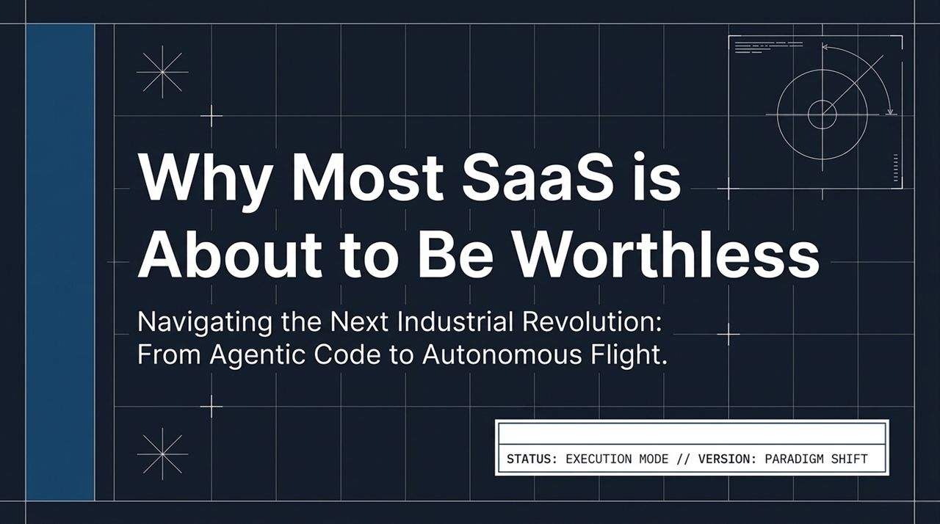
Notes:
Opening Hook: Welcome, everyone. Today, we are standing at the epicenter of a fundamental paradigm shift. We aren't just looking at an incremental software update or a typical venture capital hype cycle; we are living through the initial phases of a new Industrial Revolution.
Deconstructing the Title: The core thesis of this talk is straightforward yet disruptive: Why Most SaaS is About to Be Worthless. For the last two decades, the software business model was built on writing code, selling seat licenses, and constructing defensible software moats around repetitive tasks.
Introducing the Shift: Today, those traditional moats are dissolving. Software creation is transitioning from a high-cost labor bottleneck into an abundant, zero-cost commodity. We are moving beyond basic automation into an era of high-agency capital—where the value shifts from writing code to autonomous execution, spanning from agentic code directly to physical autonomy in the sky.
Transition: Let’s look at the core catalyst driving this reset: the crashing cost of software creation.
Why Most SaaS Companies Are About to Be Worthless
https://www.youtube.com/watch?v=cpGji-O_xtU

Slide 2
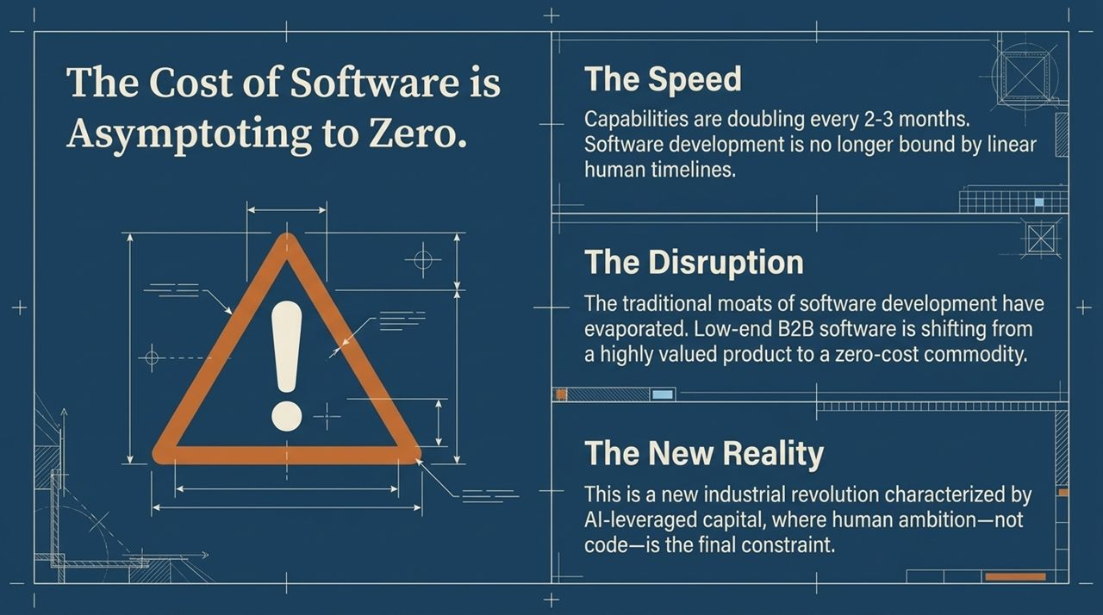
Notes:
Key Concept (Capability Doubling): The speed of technological progress is no longer operating on linear human time. AI capability and output volume are doubling every 2 to 3 months—four to five times every year. What used to take quarters of engineering roadmaps can now be achieved in an afternoon.
The Disruption of Traditional SaaS: This velocity fundamentally breaks traditional software business models. Low-end B2B SaaS—the tools that charge $20 to $50 per seat per month to handle simple data manipulation or basic workflows—are losing their moats. If software can be cleanly described, a modern agent can replicate or 'one-shot' it on demand.
The New Reality: Capital is no longer constrained by the availability or cost of engineering labor. We are entering an economy governed by AI-leveraged capital. The bottleneck has moved entirely away from implementation and syntax toward pure human ambition, product vision, and execution agency.
Transition: To understand why this is happening, let’s analyze the capability curve of these frontier models.

Slide 3
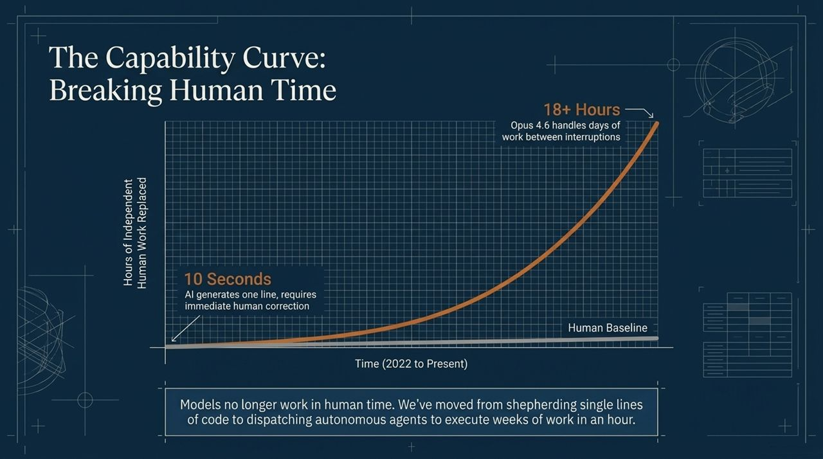
Notes:
Historical Perspective (2022 to Present): Just two to three years ago, working with AI meant 'shepherding' a single line of code. You would prompt a model, it would generate 10 seconds worth of work, make a syntax error, and require immediate human intervention.
The 18-Hour Milestone: Fast forward to today. Benchmark evaluations like the MER report show that state-of-the-art models—such as Opus 4.6—can autonomously complete over 18 hours of continuous, complex human work between interruptions.
Understanding 'Model Time' vs. 'Human Time': It is critical to clarify what this '18 hours' means. An 18-hour benchmark rating does not mean the AI takes 18 wall-clock hours to complete a task. The AI executes that equivalent workload in 1 to 2 hours. The 18 hours represents the amount of uninterrupted human labor the model accomplishes before requiring guidance.
The Compounding Velocity: Because capability doubles every few months, we are rapidly approaching an era where models will take an entire quarter's worth of engineering specifications and deliver fully tested implementations overnight.
Transition: This capability trajectory has radically altered the everyday role of software engineers.

Slide 4
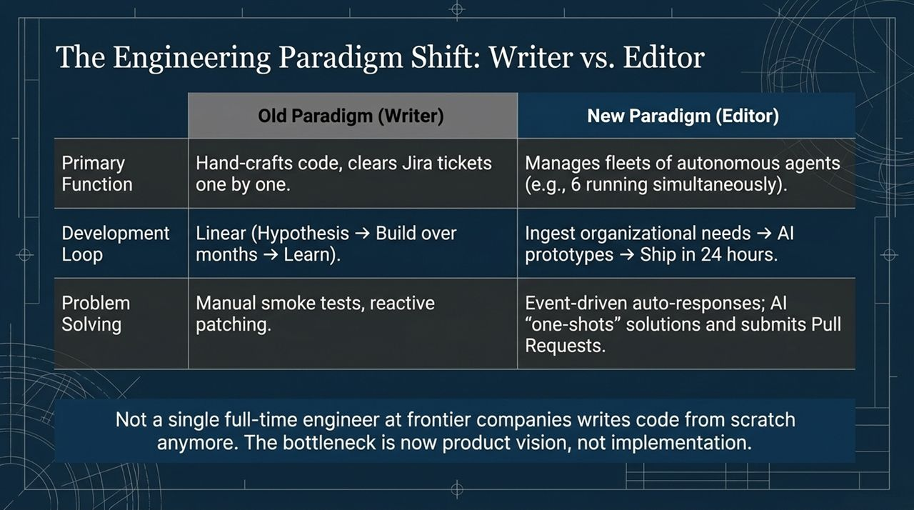
Notes:
From Crafting Code to Fleet Management: In the old paradigm, engineers were 'Writers'. They manually hand-crafted lines of code, picked off Jira tickets one by one, and spent days hunting down syntax bugs. In frontier companies today, not a single full-time engineer writes code from scratch. Engineers are now 'Editors' managing fleets of autonomous agents.
Linear Loops vs. 24-Hour Delivery: The traditional development loop was linear: formulate a hypothesis, build over six months, release to users, and gather feedback. The new development loop ingests organizational needs, lets AI build prototypes in real time, and ships fully functional features within 24 hours.
Continuous Resolution: Problem-solving has evolved from reactive patching to event-driven auto-responses. When an issue or vulnerability is detected, agents independently draft solutions, run automated smoke tests, and submit pull requests for human review.
Practical Engineering Example: Lead engineers at companies like Cognition are no longer sitting in an IDE typing code—they are directing 5 or 6 autonomous agents concurrently, dramatically multiplying their individual output.
Transition: Let’s look at how this inverted workflow functions inside an organization.

Slide 5
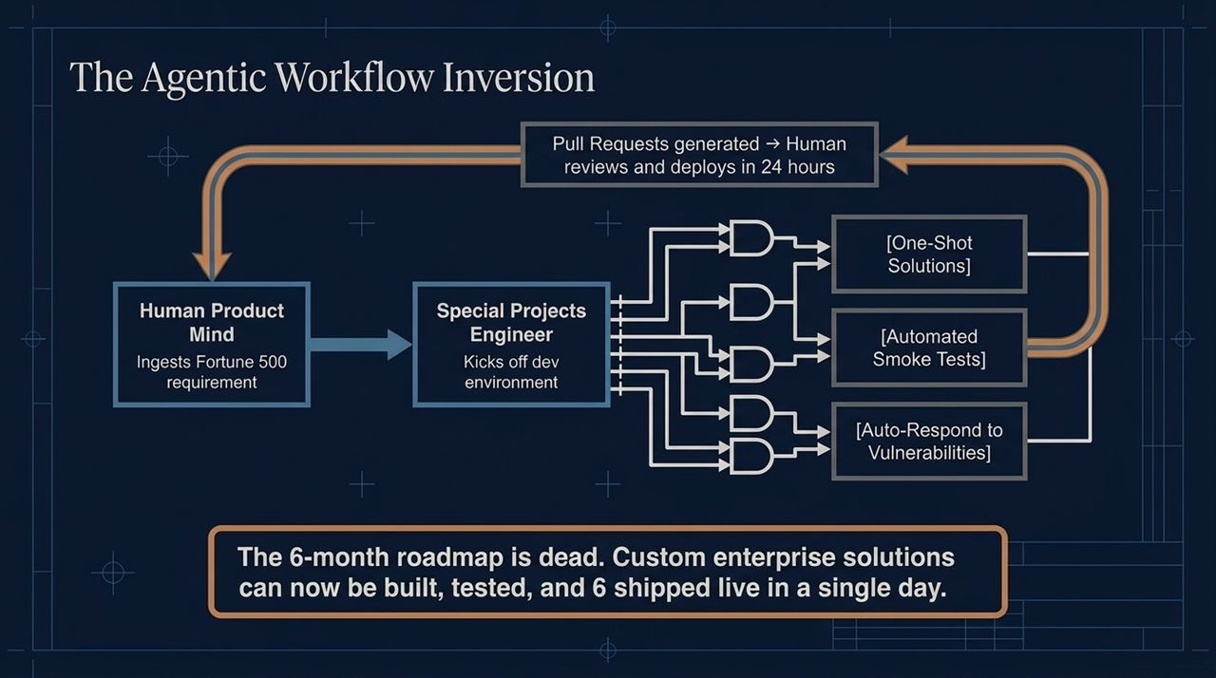
Notes:
Deconstructing the Pipeline: Here is the exact architecture of the modern high-agency engineering team. It starts with the Human Product Mind—an individual who ingests complex requirements directly from clients or market needs.
Special Projects Engineers: Instead of assigning these requirements to large engineering teams, they pass to 'Special Projects Engineers'. These engineers kick off dev environments where multiple specialized AI agents fire off simultaneously.
Parallel Execution Branches: One agent generates a one-shot solution; another runs automated smoke tests; a third checks for edge cases and security vulnerabilities. Within hours, a complete Pull Request is generated. A human reviews the code, approves it, and deploys it live—all within a single 24-hour cycle.
Death of the 6-Month Roadmap: This breaks the enterprise sales cycle. When a Fortune 500 client asks for a custom integration, you no longer tell them it's on your 6-month roadmap. You build, test, and ship it live by the next day's meeting, instantly closing deals that traditional software vendors take quarters to negotiate.
Transition: If custom software can be built overnight, what happens to value capture across the software landscape?

Slide 6
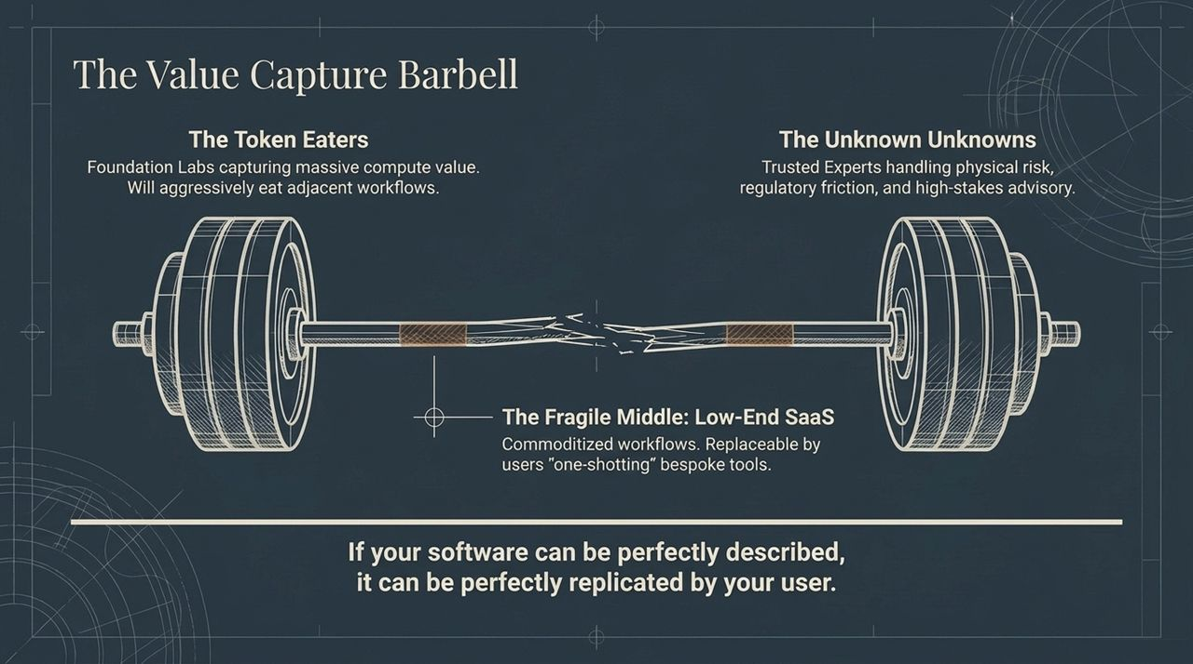
Notes:
The Fragile Middle (Low-End SaaS): The middle of the software market is in a highly precarious position. If your product simply acts as a database wrapper or standard workflow UI, it is easily commoditized. If a customer can describe your software's features to an LLM, they can build a custom internal tool tailored precisely to their needs.
End 1: The Token Eaters (Foundation Labs): On one end of the barbell are the frontier model labs—OpenAI, Anthropic, Google. They monitor where high volumes of API tokens are consumed and aggressively build native capabilities to capture those workflows.
End 2: The Unknown Unknowns (Trusted Experts & Physical Risk): On the other end are trusted domain experts who manage physical risk, regulatory compliance, complex financial structures, and deep real-world friction. These platforms sell outcomes and risk management rather than raw software subscriptions.
Key Takeaway: Value is fleeing the middle. Companies must either provide foundational platform infrastructure or offer deep domain expertise and real-world risk management.
Transition: This collapse in software creation costs is driving a massive explosion in a new business model: the Micro-Enterprise.

Slide 7
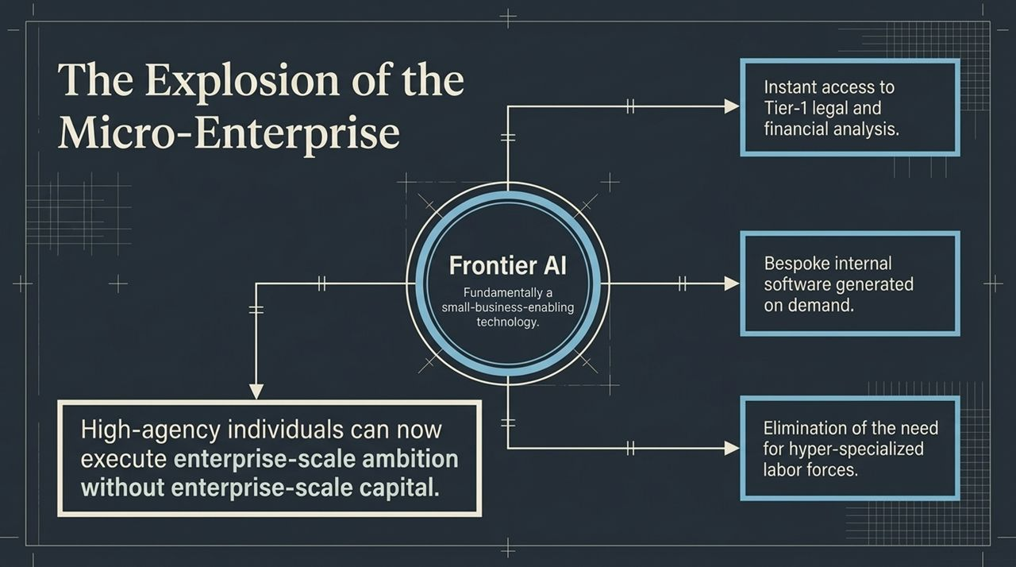
Notes:
Democratizing Enterprise Power: Frontier AI is fundamentally a small-business enabling technology. Historically, starting a competitive enterprise required massive initial capital to hire dedicated legal, accounting, product, and engineering teams.
Leveling the Field: Today, a single high-agency founder equipped with frontier models can access Tier-1 legal analysis, instant financial modeling, and bespoke software generation on demand.
Elimination of Specialization Bottlenecks: Small teams no longer need massive administrative overhead. Hyper-specialized labor forces are replaced by agile generalists who leverage agents across diverse functions.
The High-Agency Advantage: This allows agile individuals to execute on enterprise-scale ambitions without requiring traditional enterprise-scale venture capital.
Transition: This force multiplier isn't limited to digital tools—it is moving rapidly from bits to atoms.

Slide 8
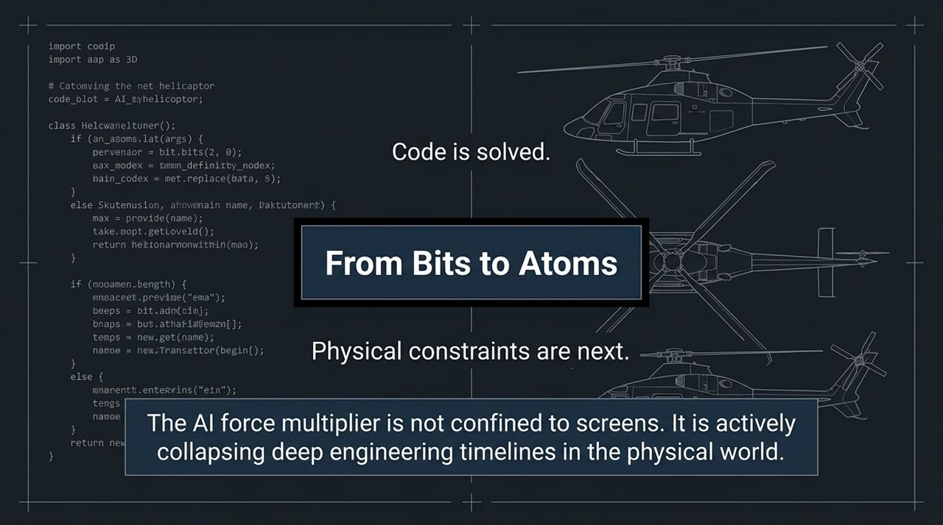
Notes:
Expanding Beyond Screens: While the software world has felt the immediate impacts of AI, physical engineering and deep-tech manufacturing are undergoing a parallel revolution.
Solving the Digital-to-Physical Gap: Code is largely solved; the next frontier lies in navigating physical constraints, material sciences, and complex engineering timelines.
Accelerating R&D Cycles: In hardware, aeronautics, and defense, engineering iterations traditionally took years of manual prototyping, wind-tunnel simulations, and physical tests.
Compressing Decades into Years: By deploying agentic simulation tools and deep compute to physical engineering problems, hardware companies are compressing 20-year development roadmaps into a fraction of the time.
Transition: Let's examine a real-world case study of this physical force multiplier in action at Joby Aviation.

Slide 9
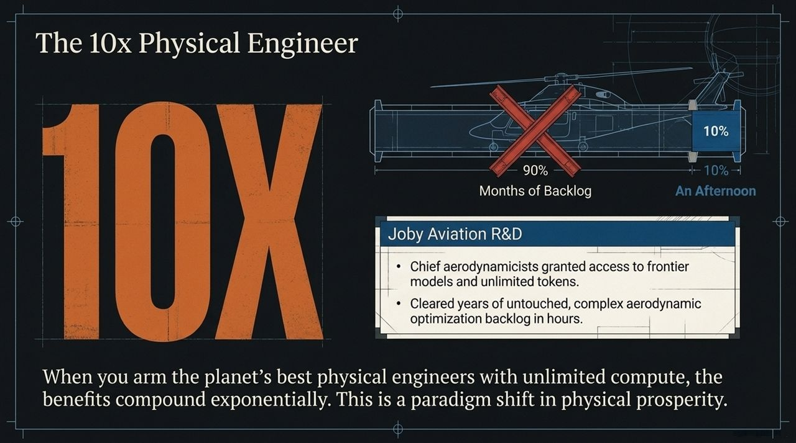
Notes:
Case Study (Joby Aviation R&D): Joby Aviation, a leader in electric vertical takeoff and landing (eVTOL) aircraft, provides a clear example of this impact. When their chief aerodynamicists were granted access to frontier models and unlimited compute tokens, the impact was immediate.
Clearing Years of Backlog in an Afternoon: Top aerodynamics PhDs had backlog lists of design optimizations and complex calculations that had sat untouched for years due to resource constraints.
Superhuman Engineering: Equipped with specialized AI agents, these engineers cleared months of complex aerodynamic calculations in a single afternoon, generating brand-new aircraft design iterations that performed up to 5x to 10x better.
Compounding Prosperity: Arming top physical engineers with unlimited compute generates exponential compounding gains. This represents a fundamental shift in how physical products, vehicles, and infrastructure are built.
Transition: How do these engineering breakthroughs integrate into a viable real-world platform? Let me introduce the Convergence Stack.

Slide 10
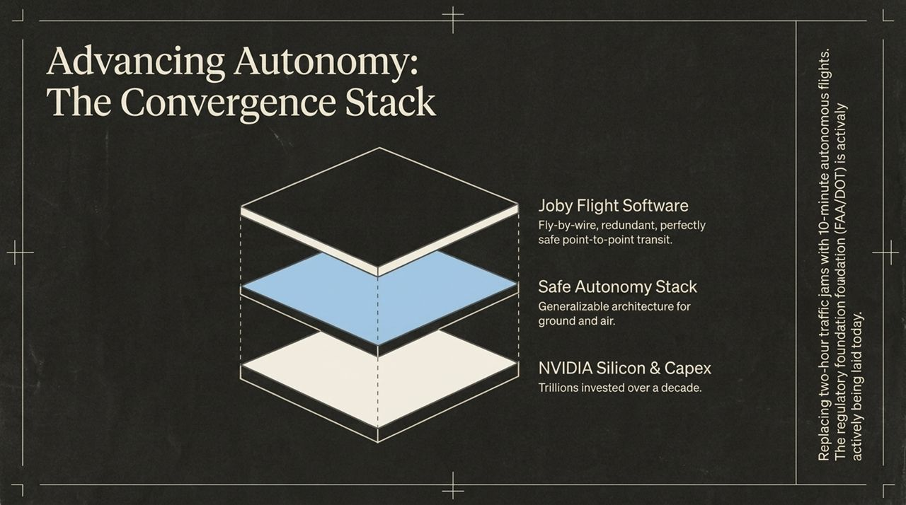
Notes:
The Layered Foundation: Achieving safe, autonomous point-to-point physical transit requires three core layers operating in harmony:
NVIDIA Silicon & Capex: Trillions of dollars of underlying compute infrastructure and specialized autonomous silicon chips built over a decade.
Safe Autonomy Stack: A generalizable autonomous software architecture capable of managing real-time flight, obstacle avoidance, and sensor fusion across ground and air.
Joby Flight Software: Redundant, fly-by-wire flight control systems engineered for commercial safety standards.
Solving Real-World Friction: The goal is to transform 2-hour urban traffic gridlocks into quiet, 10-minute autonomous flights.
Regulatory Modernization: This is not theoretical science fiction. Federal authorities (FAA and DOT) are actively establishing operational frameworks and testbed programs across multiple states to safely integrate these systems into national airspace.
Transition: Building autonomous aircraft is only half the battle; we also need to rethink power density and propulsion.

Slide 11
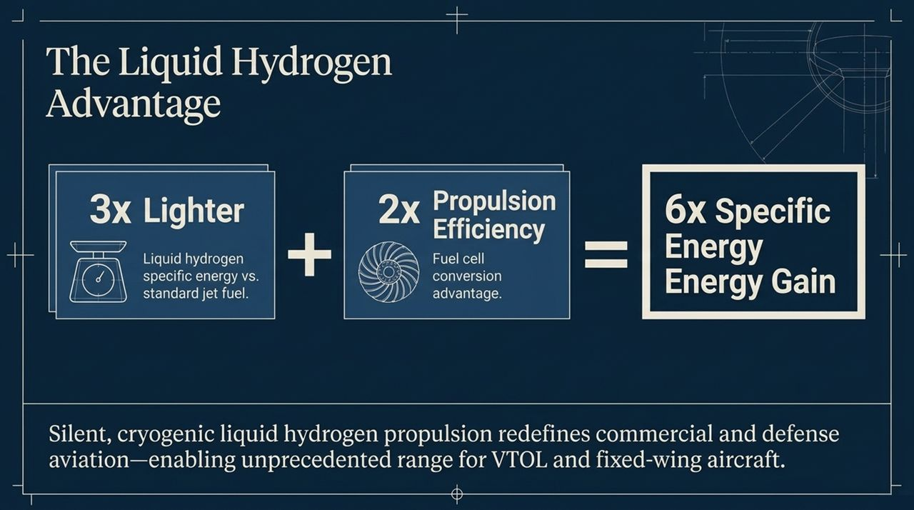
Notes:
Breaking Battery Limits: While lithium-ion batteries work well for short regional hops, long-range aerospace requires significantly higher energy density.
The Physics Breakdown:
3x Lighter Specific Energy: Cryogenic liquid hydrogen offers three times the specific energy density of standard jet fuel by weight.
2x Fuel Cell Conversion Efficiency: Passing liquid hydrogen through advanced fuel cells converts chemical energy into electrical propulsion twice as efficiently as traditional combustion engines.
6x Total Energy Advantage: Combining weight savings with fuel cell efficiency yields a net 6x performance advantage over legacy jet fuel systems.
Market Impact: Quiet, zero-emission liquid hydrogen propulsion expands the operational range of both VTOL and fixed-wing aircraft, opening up regional air mobility and defense applications.
Transition: With technology advancing rapidly across software and physical engineering, let's step back and look at the macro picture—are we in an AI capital bubble?

Slide 12
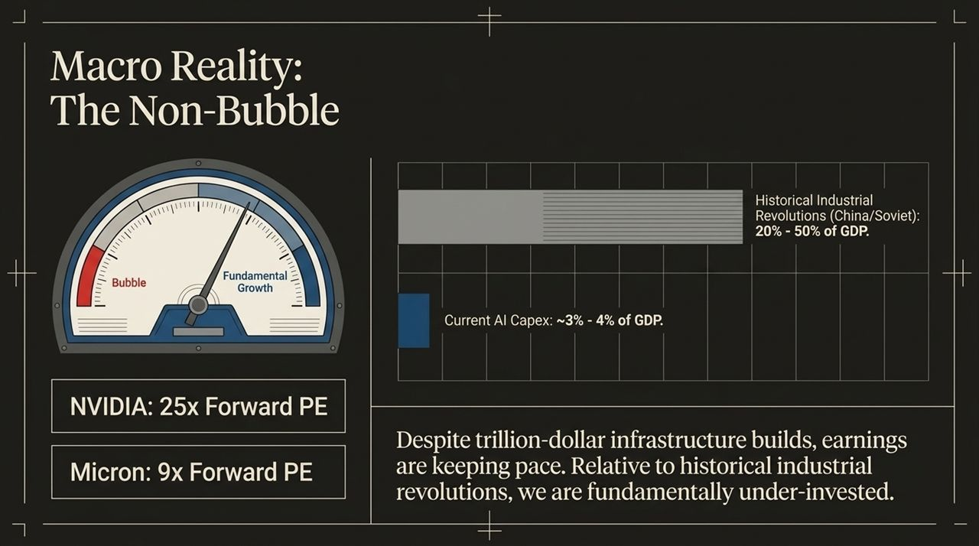
Notes:
Addressing the 'AI Bubble' Question: Public markets and financial commentators frequently ask whether massive AI capex spending indicates an unsustainable bubble. The data suggests otherwise.
Historical Capex Comparisons: During historical Industrial Revolutions (e.g., Soviet industrialization or modern China), infrastructure investment reached 20% to 50% of national GDP. Current global AI capex sits at just 3% to 4% of GDP. Relative to past transformational buildouts, we remain structurally under-invested.
Valuations Grounded in Earnings: During the dot-com bubble, non-profitable internet companies traded at astronomical revenue multiples. Today, key hardware enablers trade at reasonable forward P/E multiples—NVIDIA trades around 25x forward earnings, while Micron sits at roughly 9x forward earnings. Revenue and earnings growth are keeping pace with capital deployment.
Transition: If the technology is proven and financial valuations are supported by revenue, what is the primary bottleneck slowing down economic impact?

Slide 13
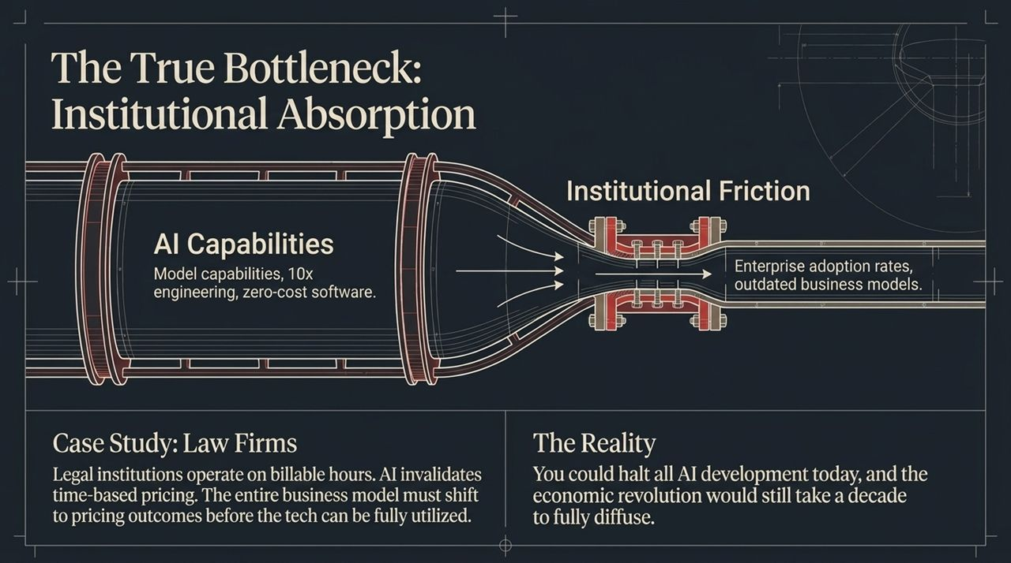
Notes:
Technology vs. Diffusion: The primary constraint on economic growth is no longer model capability—it is institutional absorption capacity. You could freeze all frontier model development today, and it would still take a decade for the broader economy to fully adopt and integrate existing capabilities.
Case Study (Professional Services & Law Firms): Consider the legal sector. LLMs excel at core legal tasks: document ingestion, discovery, research, and contract drafting. However, law firms historically monetize based on the billable hour. AI drastically reduces the hours required to complete tasks, directly conflicting with their legacy business model.
Business Model Shift: For legal institutions to leverage AI effectively, they must fundamentally change their business models from charging for time to pricing structured outcomes. This structural shift requires organizational redesign, compliance updates, and cultural adaptation.
Transition: As this adoption process unfolds across society, we must proactively manage the resulting economic and social friction.

Slide 14
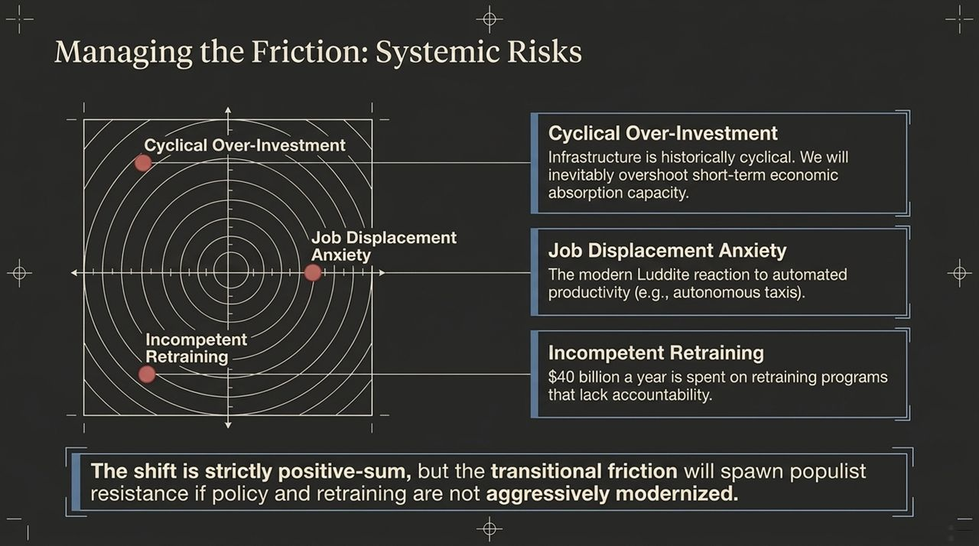
Notes:
Recognizing Transitional Friction: Technological revolutions are positive-sum over the long term, but the transition creates real friction that requires careful management.
Three Primary Risk Vectors:
Cyclical Over-Investment: Infrastructure spending moves in cycles. Markets inevitably overshoot short-term economic absorption capacity, leading to localized corrections before steady growth resumes.
Job Displacement Anxiety: As automation expands from routine tasks to cognitive labor and physical transit (e.g., autonomous taxis), public anxiety grows. Unaddressed, this fear can spark populist pushback and heavy-handed regulation.
Incompetent Retraining: Over $40 billion is spent annually on legacy worker retraining programs that lack accountability or measurable skill outcomes.
Policy Imperative: We must modernize workforce retraining and policy frameworks to ensure economic gains are widely distributed while minimizing societal friction.
Transition: This brings us to our concluding takeaway on navigating the High-Agency Era.

Slide 15

Notes:
Summarizing the Thesis: We are entering a transformative era of economic leverage:
Technology is no longer the bottleneck.
Capital is no longer an insurmountable moat.
Custom software costs are approaching zero.
Hardware engineering and physical R&D cycles are compressing exponentially.
The High-Agency Mindset: The single remaining constraint is human ambition and agency. Individuals and agile teams who take initiative, leverage autonomous agents, and execute with clarity can build world-changing companies faster than at any point in history.
Call to Action: System is ready. The tools are live. The time to build is right now.
Transition: Let's summarize the key takeaways visually on our final slide.

Slide 16
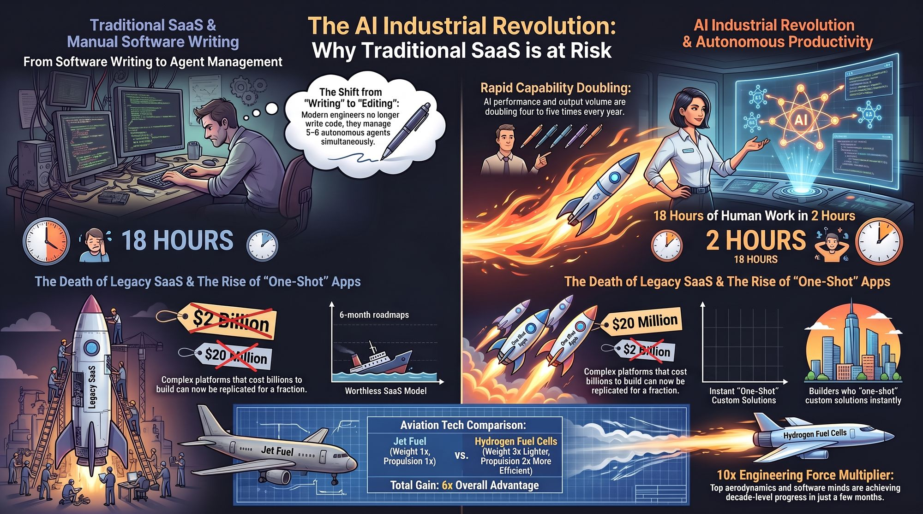
Notes:
Software Shift: Software engineering has permanently moved from manual writing to managing multi-agent fleets. Complex software systems that once required hundreds of millions of dollars to build can now be created and customized in real time.
Legacy SaaS Disruption: Legacy SaaS tools with multi-year implementation cycles face disruption from bespoke, 'one-shot' applications built on demand to solve specific customer workflows.
Hardware & Energy Amplification: In the physical world, compute acts as a force multiplier. Combining 10x engineering velocity with zero-emission technologies like liquid hydrogen (delivering a 6x net efficiency gain) paves the way for scalable autonomous transit.
Closing Remarks: We are living through a fundamental economic shift. The winners of this era will be the high-agency builders who harness compute to solve hard, real-world problems. Thank you.
Why Most SaaS Companies Are About to Be Worthless
https://www.youtube.com/watch?v=cpGji-O_xtU

